Slide 1
Painting vs Photograph Classification

Slide 2
Links to the code
Link to the dataset
https://www.kaggle.com/datasets/iiplutocrat45ii/painting-vs-photograph-classification-dataset
Link for first data classification approach (sequential model) –
https://drive.google.com/file/d/16XZMveJP05ox6IUnm8RITkNP9bNH42O7/vie w?usp=sharing
Link for improvised data classification approach (k fold approach) –
https://colab.research.google.com/drive/1ur-RUeAJ_IziYn0Zoi5mQaxtSmC_GaE?usp=sharing

Slide 3
Outline
Abstract
Literature survey
Data set
Phase 1
Phase 2
Conclusion

Slide 4
Abstract
The Instagram art scam is gaining popularity and to prevent this the painting vs photograph classification can be quite helpful.
The classification involves analysing various parameters by building a sequential approach in the former and the 5 fold cross checking in the later approach.
The main goal is to derive an approach which guarantees maximum accurate classification by analysing previous work in the same field and improvising it.

Slide 5
Literature survey
Article | Key design choice / Algorithm | Highlights of proposed system | Limitations of proposed system
Estimating the photorealism of images: distinguishing paintings from photographs. Florin Cutzu Et al. | Perceptron based Neural network classifiers. | Accuracy of 71% for photographs and 72% for paintings. ages. Mean image size was for paintings is 534*497 pixels. For photographs mean image size was 568*506 pixels. | Highly depended on colour, edge and texture which may not accurately represent the complexity of distinguishing.
Classification of images as photographs or paintings using convolution neural network. Jos´e Miguel L´opez-Rubio Et al. | Convolution neural network using the VGG16-layer version. | AU ROC is above 0.94 after 100 epochs. The images used are of 299*299 pixel. | Requires large amounts of data and computational resource for training. Computation time for 100 epochs is very high.
Distinguishing painting vs photographs by complexity estimates Adrian Carballa Et al. | Edge detection, compression. | Accuracy of 84.28% is observed for 20 epochs. The images used are of 256*256 pixel. | The number of epochs is 20. Accuracy is not that reliable.

Slide 6
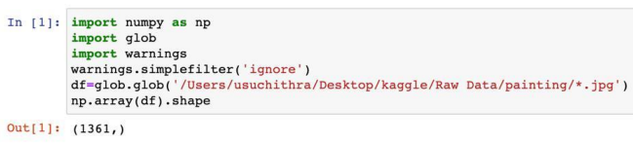
Data set
Total of 1361 paintings and 3747 photographs have been take in the dataset covering various categories - portrait, realism, digital painting, fine art photography, astrographs, etc.

Slide 7
Phase 1
The approach involves converting images to grayscale, resizing to 64x64 pixels.
The neural network architecture is built on the sequential model and employs Conv2D, MaxPooling2D, Dense, and Flatten layers.
Categorical cross-entropy is the chosen loss function. With 58,996,098 trainable parameters, our model is trained over 50 epochs.
The results are visualized through accuracy and loss graphs. The model has achieving an accuracy of over 95%.

Slide 8
Phase 1 - approach
Data Pre processing
Convert paintings and photographs to grayscale.
Resize images to 64*64 pixels.
Combine data frames.
Model Setup
Calculate trainable parameters using formula (n+1)*m.
Total trainable parameters: 58996098.
Neural Network Training
Set up neural network architecture.
Train for 50 epochs.
Results Analysis
Plot accuracy and loss graphs.
Model Performance
Achieved over 95% accuracy after 50 epochs.

Slide 9
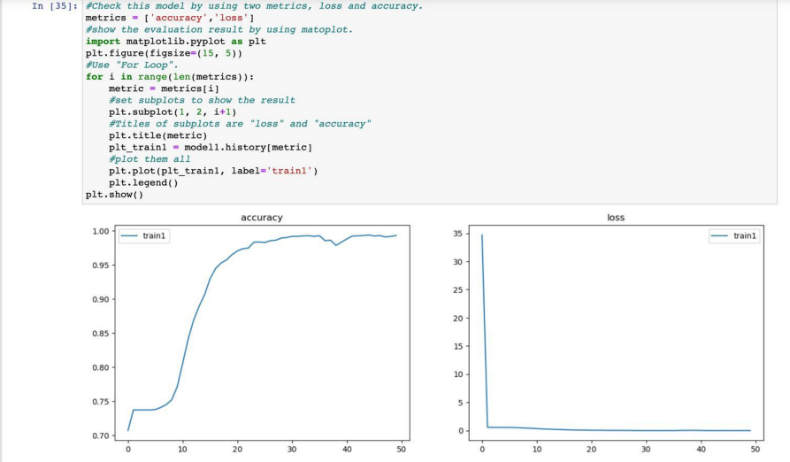

Slide 10
Phase 2

Slide 11
Phase 2 - approach
K-Fold Cross-Validation
Divide dataset into k equal subsets.
Iteratively use one subset as the test set and the remaining k-1 subsets for training.
Repeat the process k times with different test sets.
Performance Evaluation
Average evaluation scores over k iterations.
Obtain a more reliable measure of model performance.
Result
K-fold cross-validation yields an average accuracy of 73.06%.

Slide 12
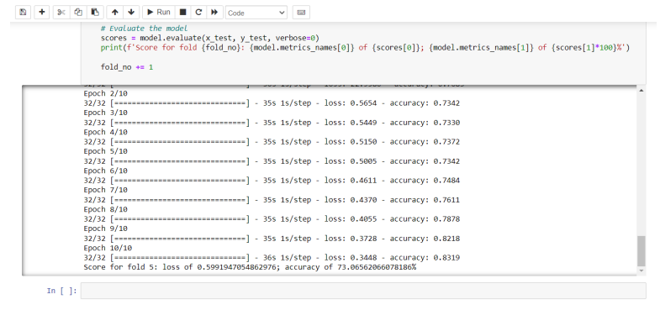
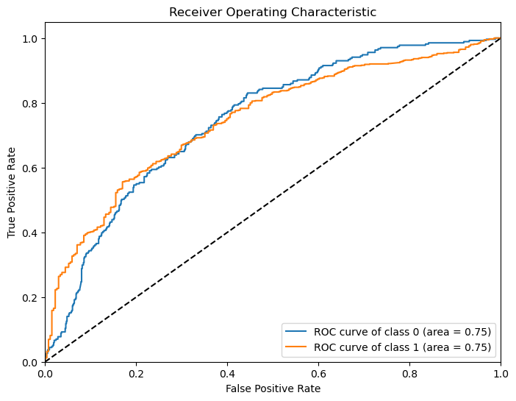

Slide 13
Comparison
The Phase 1 showcased the model's performance on a single train-test split, Phase 2 introduced a more comprehensive evaluation strategy with k-fold cross-validation.
The accuracy of over 95% in Phase 1 provides a more realistic and dependable representation of the model's performance in real-world scenarios.
The adoption of k-fold cross-validation in Phase 2 reflects a commitment to robustly assessing the classification model and acknowledging its potential variability across different data partitions.
Overall, the combined insights from both phases contribute to a more comprehensive understanding of the model's strengths and limitations.

Slide 14
Thank you

